Slide 1
Cloud Automation Manager (CAM)
John Abbott jabbott@us.ibm.com
John Webb john.webb@us.ibm.com

Slide 2
Objectives
After completing this lecture, you will be able to:
Discuss several multi-cloud management use cases
Describe how Cloud Automation Manager fits into several multi-cloud management use cases
Describe the architecture of a Cloud Automation Manager installation
Understand how Cloud Automation Manager integrates with DevOps tool chains
Describe Cloud Automation Manager pricing and packaging plans

Slide 3
Enterprises are increasingly turning to multi-cloud strategies to accelerate innovation
The average enterprise is running 5 or more clouds ⁽¹⁾
Significant growth in hybrid cloud adoption ⁽²⁾
+
Public
Private
Challenges
Managing complexity - multiple clouds, tools, and services
Optimizing solutions - workload placement, costs
Managing compliance and security
Maintaining low friction oversight, governance and control
(1) Forbes & Gartner
3
(2) RightScale Cloud Computing Trends: 2016 State of the Cloud Survey

Slide 4

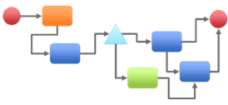







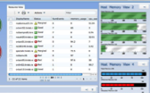



Clients require multi-cloud management across a spectrum of workloads
Organizations are embracing new business models and disruptive technologies to be competitive, meet business need, and innovate
Cloud enabled
Cloud native
Extend
optimize investments
drives need
Innovate
Integration
Focus on integration and scale
Expose and monetize existing services
Extend existing workloads on Cloud
Operational automation
Analytics-based visibility on progress
Focus on speed and agility
Cloud First assembly of services
Agile DevOps model
Continuous delivery
User first delivery model
Hybrid Cloud
4

Slide 5
Multi-cloud management use cases
Use Case #1
Use Case #2
Use Case #3
Self service access to cloud infrastructure and application services.
Automate provisioning of infrastructure and applications in any cloud
Manage workload and service lifecycle across multiple clouds
For Developers and DevOps teams
to innovate with speed
For DevOps and IT Operations teams
to deploy with speed and control
For IT Operations teams to optimize workloads for performance, cost, and compliance
Cloud Automation Manager
provides multi-cloud management capabilities to address these top use cases
5

Slide 6
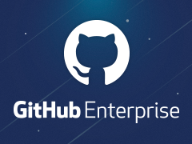




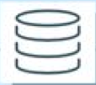





Introducing Cloud Automation Manager
Cloud Automation Manager
Automate provisioning of infrastructure and application stacks in any cloud
Get started fast with full stack automation built with open technology using Terraform configurations and Chef recipes in IBM Cloud ⁽¹⁾ , VMware, AWS, Azure & PowerVC
Accelerate development velocity with automated provisioning of bare metal servers, VMs, cloud native services, containers and complex infrastructure stacks
Improve development team effectiveness and governance by managing infrastructure-as-code
Accelerate delivery of applications into production by leveraging a marketplace of pre-built content built to best practices
Deliver composed services with orchestration through a self-service catalog
Simplify delivery of application environments to end users with composed services, orchestration and self service
Graphically compose services comprised of Terraform configurations, variable pre-sets, Helm charts, simple conditional logic (if/else), email notifications and order forms
Federate services into catalogs with Open Service Broker
Manage workload and service lifecycle across multiple clouds
Manage running service and workload instances with topology centric and resource centric controls
Deployment & Process Orchestration
Template Library
Service Composer
3rd Party Integrations
Flow Engine
Template Management
Instance Management
Market place
Template API
Workload
Terraform
K8s Helm
Service
Multi-cloud Management Services
Public cloud
Private cloud
Containers
Virtual environments
On-prem systems
(1) IBM Bluemix and Softlayer
6

Slide 7

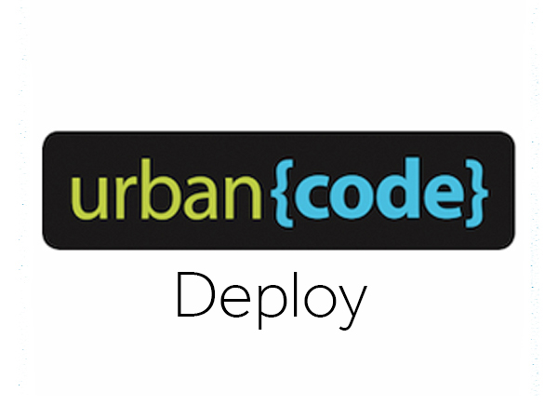

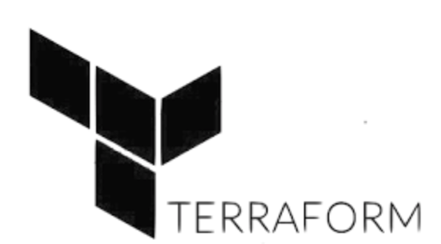
Full stack automation, integration with DevOps tool chains
Use case #2
Automate provisioning
Process Integration
Business processes automation
Approvals
Business Process
Enterprise Integration
Application Delivery
Integration with application delivery tool chains
Full stack automation including bare metal servers, VMs, network, cloud native services, containers, middleware and applications
Built with open technology
Flexible
Enterprise-ready
Application Code
Software Configuration Management
Based on Chef industry standard to leverage skills and existing automation
Middleware Configuration
Middleware
OS configuration
Infrastructure automation
Based on Terraform open source for a broad ecosystem
OS
Virtualization
Servers
Storage
Networking
7

Slide 8
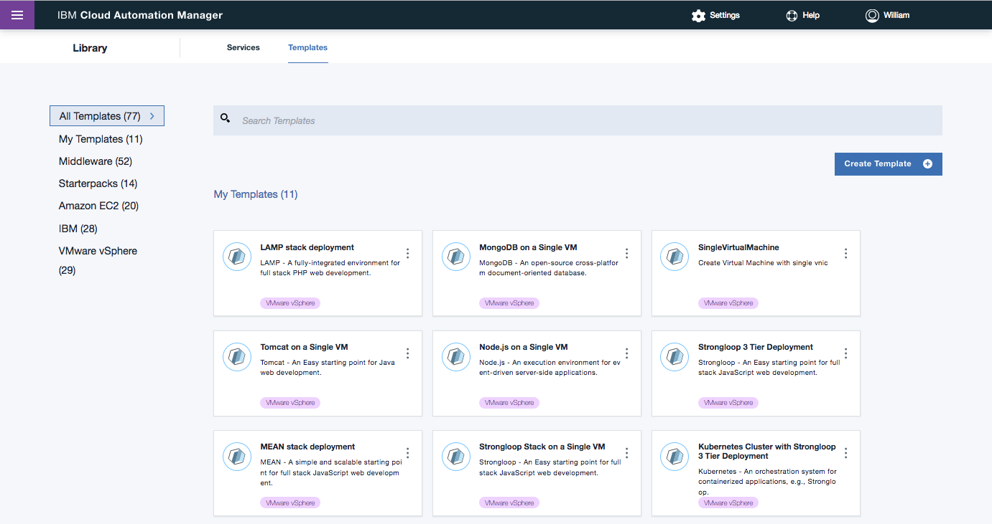
Self Service Catalog – consumer view
Use case #1
Self service access
The services you need when you need them
e
Rapidly deliver applications and infrastructure on multi-cloud environments - IBM and 3rd party, private and public, VMs and containers
Simplify delivery of application environments by hiding automation complexity and locking down environment configurations
Streamline fulfilment processes to deliver application and infrastructure workloads aligned to the needs of the business
Deliver application environments as a service to CI/CD tool chains
8

Slide 9






Self Service Catalog – provider view
Use case #1
Self service access
Automate everything with service composition & orchestration
e
Compose services with a graphical editor – drag and drop components from a pallet onto a canvas
Services can contain:
Terraform Configurations & variable pre-sets
Helm Charts
Simple conditional logic (if/else)
Notifications (email)
Order forms
Services are published into a service catalog leveraging Open Service Broker API
Roadmap
Support more advanced workflows
IBM BPM integration
Deployment & Process Orchestration
3rd Party Integrations
Service Composer
Flow Engine
Template
Service
Catalog
Variables
Service
Composer
Service
Object
Helm Chart
Logic
Notifications
Order Forms
9

Slide 10
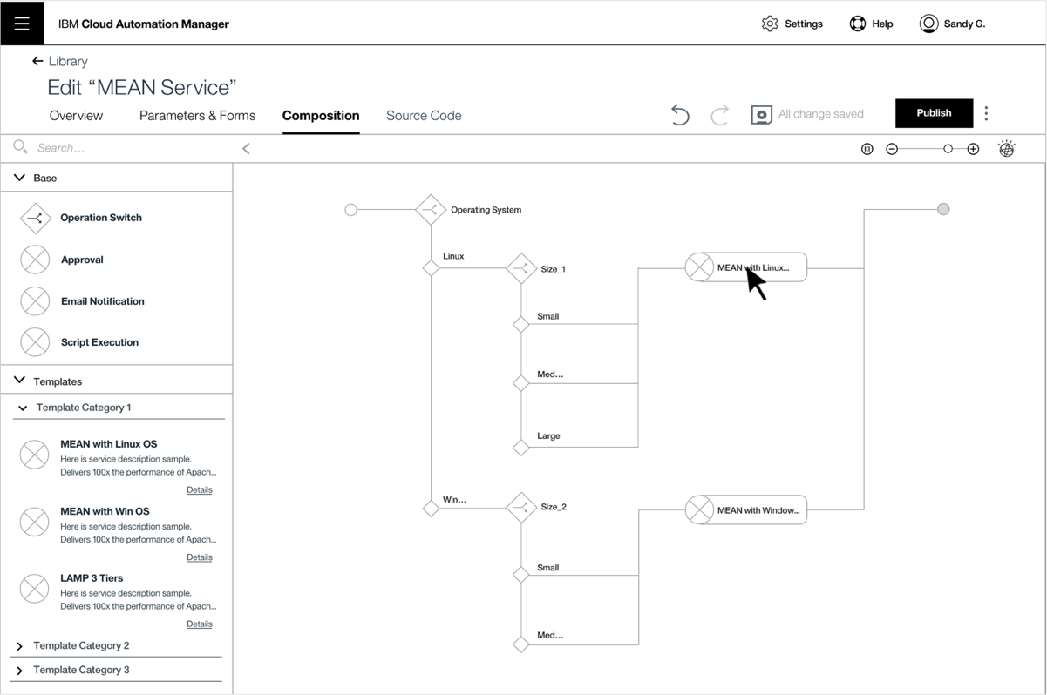
Self Service Catalog – provider view
Use case #1
Self service access

Slide 11
Self Service Catalog - Compose, publish, consume and operate
3
Publish
Terraform
1
Compose service
CAM Service Broker
Variables
ICP Service Catalog
CAM Graphical
Service Composer
Developer Consumer
Order Forms
Push
Service
Object
Service
Object
6
Consume
5
2
Save composed service
Service
Object
Service
Object
Helm Charts
Service
Object
Service
Object
Logic
CAM Service Object Store
Notifications
4
Get Info
7
Provision
Service Management
CAM Flow Engine
Service Instance Management
9
Operate
8
Orchestrate
ICP API
CAM Core Provisioning
Helm
Terraform

Slide 12

Using Terraform Configurations is simple and easy
Use case #2
Automate provisioning
Modify existing or
Create new
7
Use your environment
4
Select a template
2
Your running instance
3
CAM Template Library
Import a reference
Your resources are provisioned
6
Review and apply your plan
5
Lamp Stack
DB2
Clone from
marketplace
MQ
1
WAS Liberty
MQ
Marketplace
Created by
You
Your org
IBM
3rd party
Stored in
GitLabs
GitHub Enterprise
GitHub
12

Slide 13

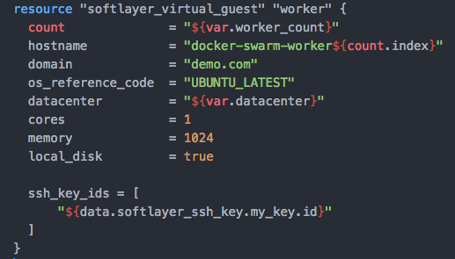


Anatomy of a Terraform Configuration
Use case #2
Automate provisioning
Resources
Components of your infrastructure (compute, network, storage)
Resource
Configuration
For a component in your infrastructure
Anatomy of a
Terraform Configuration
Configuration
Infrastructure defined as code
Logic
Chef recipes and scripts
Var = Value
Documentation
README
Var = Value
Var = Value
Operations
Chef recipes and scripts
Variables
Define the parameters of your resource
13

Slide 14

Managing cloud infrastructure as code
Use case #2
Automate provisioning
Store Terraform configuration in Git, manage infrastructure as code
Accelerate development velocity with reusable infrastructure based on open source Terraform
Improve governance and transparency by tracking the ‘who’, ‘what’, ‘when’ and ‘why’ of all environment changes
Improve development team collaboration by enabling team members to easily share application environments
Reduce configuration drift by making it easy to track changes to your running environment
Infrastructure as code (IaC) is the process of managing and provisioning computer data centers through machine-readable definition files, rather than physical hardware configuration or interactive configuration tools
Source: https://en.wikipedia.org/wiki/Infrastructure_as_Code
14

Slide 15
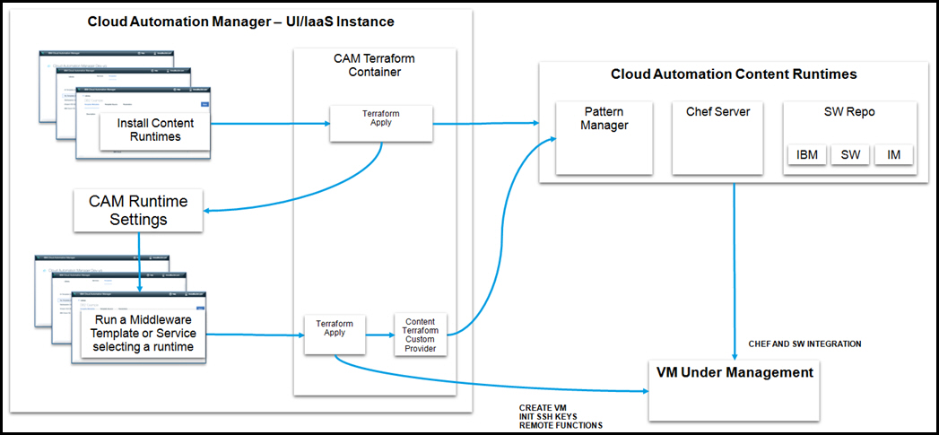
Cloud Automation Manager Chef Content Runtime support
Use case #2
Automate provisioning
Built-in Chef Server runtime
Optional Chef runtime that can be easily deployed into your provider cloud to support IBM Chef enabled content
You supply the virtual server, let CAM stand-up a pre-configured Chef runtime
Fully containerized for maximum portability
Integrated software repository
15

Slide 16
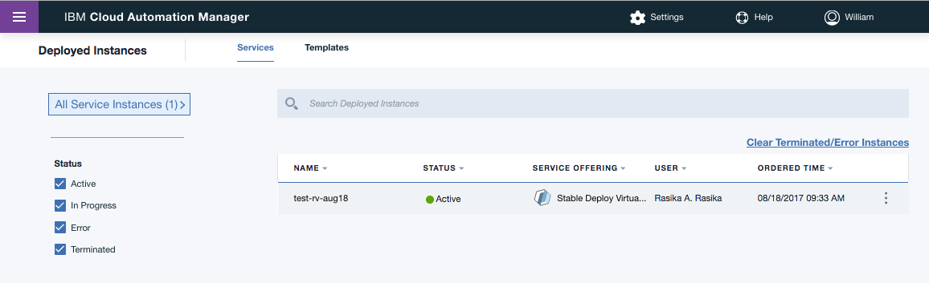
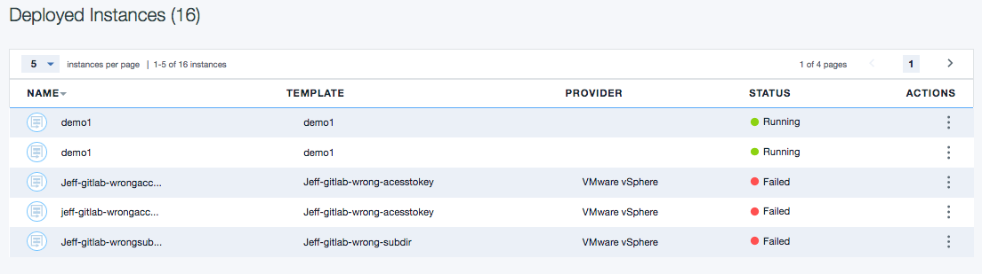
Workload and Service Instance view
Use case #3
Manage workload & service lifecycle
Manage workload and services instances from an integrated console
e
Manage lifecycle of VM and cloud resources
Workload and Service instance views
Rollout and rollback infrastructure updates with Terraform Plan and Apply
Integrate with monitoring and logging tools, native cloud consoles and day 2 management tools (UCD, APM, ServiceNow, Splunk, etc.)
16

Slide 17
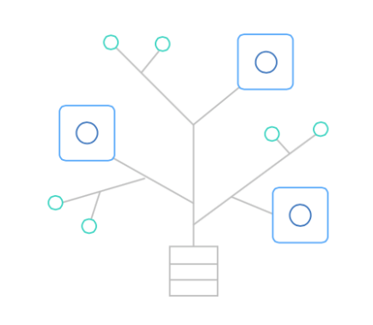
Marketplace of pre-built automation content
Use case #2
Automate provisioning
Content Marketplace
e
Accelerate projects into production by leveraging pre-build curated Helm Chart, Terraform Configurations and Chef scripts
Catalog of IBM Middleware content, built to best practices for consistent high quality
Interoperable in IBM Cloud (private, dedicated, public)
Reusable and customizable to adapt to specific business requirements
Fully supported with updates and distribution
Terraform configurations:
WAS ND, WAS Liberty, DB2, MQ, MEAN stack, LAMP stack, Strongloop stack, Kubernetes clusters, MongoDB, Node.js, Amazon EC2 virtual servers, IBM Cloud virtual servers, VMware virtual servers, MySQL
Chef cookbooks:
WAS ND, WAS Liberty, DB2, MQ, MySQL
17

Slide 18
Multi-cloud management with Cloud Automation Manager
CAM extends IBM Cloud Private with capabilities to automate workloads in VMware, AWS EC2, Azure, PowerVC, and IBM Cloud
CAM is implemented with Docker containers and installed into IBM Cloud Private with a Kubernetes Helm chart
CAM is fully entitled as a component of IBM Cloud Private. CAM is only available as a component in IBM Cloud Private
CAM leverages Terraform and infrastructure as code for multi-cloud management
Cloud Automation Manager
Template Library
Workload Automation
Service Composition &
Orchestration
Instance
Management
Multi-cloud management services
IBM Cloud Private
Self-service catalog
Infrastructure
Data & Analytics Services
Multi-cloud
Core Services
Kubernetes
Databases
Analytics
CAM
IAM
Logging
Audit
API & Data Connect
Encryption & Key Management
Monitoring
Usage
Metering
Event
Tenant Svcs
Notes:
It is taking a village to pull this together. Runs on Power, GTS managed services, Systems group help, consistent use cases with public
Small squads with every person delivering, including leaders
3-5 people per development squad
2-3 people per business squad: OM, Pricing, Licensing, RFA creation, New PIDs, naming, sales
Leveraged a broad IBM team across business units, capitalizing on team specific expertise
Private Cloud team, Hybrid CTO office, Spectrum conductor team, Cloud marketing, Pricing, RFA team, New Product team (PID creation), C&C sales team, Cloud Services sales team

Slide 19
Packaging and pricing - Frequently asked sales questions
My client is interested in CAM. What do I need to sell?
You need to sell IBM Cloud Private (ICP) part numbers. CAM capabilities are included in the ICP product package. ICP is offered in three packages: Cloud Native, Cloud Modernization, Data Scientist editions. All of them include CAM.
What are the combined capabilities of CAM and ICP?
ICP is a platform to build, deploy and manage workloads on Kubernetes containers and Cloud foundry environments. CAM adds the capability to deploy VM based applications on on-premises and off-premises clouds and to self serve and orchestrate both VM and container workloads.
For a detailed description of ICP capabilities, you can refer to the ICP collaterals.
If I sell ICP to a client that wants to use CAM capabilities, can he also use ICP capabilities such as managing containers?
Yes. Once you sell one of the three ICP packages, the client can use any capability included in the package. So for example, “ICP Cloud Native Edition” can be used to automate deployment of VM based workloads on Amazon and VMware and at the same time on a local Kubernetes cluster. Of course all three environments must be covered by sufficient entitlement.
What is the pricing metric of IBM Cloud Private
Virtual Processor Cores. It is a metric well suited to measure the size of on-premises environments (e.g. Vmware, Kubernetes), as well as public clouds (e.g. IBM Cloud, Amazon)
ICP will be offered with perpetual licenses as well as monthly licenses
If my client buys entitlement for 100 VPC of ICP, what can he manage with it?
There are three possibilities
He is mostly interested in CAM; he can manage VMware, AWS or any other cloud supported by CAM up to a maximum of 100 VPC
He is mostly interested in managing Kubernetes workloads: he can manage Kubernetes clusters up to a maximum of 100 VPC
He wants to use both capabilities: he can use any combination of the above two cases, up to a total size of the managed environment of 100 VPC
Is there a cross-sell (land & expand) opportunity from CAM to ICP or vice versa?
Yes. For clients using CAM, ICP capabilities are readily available to extend the value for clients to create, connect, and optimize workloads leveraging IBM and 3rd party middleware, data and developer services available in the ICP catalog
For clients using ICP, CAM capabilities are readily available to extend the value for clients to automate and manage multi-cloud environments

Slide 20
ICO and Pure - Frequently asked sales questions
I have an ICO / Pure client. Can they use the new CAM capabilities in ICP.
Yes, ICO and Pure clients will be entitled to use CAM capabilities in ICP at no additional licensing cost.
How can ICO / Pure clients be entitled to use CAM / ICP
The ICO and Pure software bundles will be updated to include the CAM/ICP software. Existing clients can download the new ICO / Pure bundle, which will then include the new CAM / ICP capabilities
The ICO and Pure license will be updated to include CAM/ICP as a “supporting program”, thus allowing ICO / Pure clients to use CAM/ICP.
Will there be additional licensing costs for ICO clients?
No. ICO / Pure clients will continue to use their existing ICO / Pure entitlements, and will continue to pay maintenance as part of their standard Service & Support entitlement.
How much quantity of CAM/ICP entitlement will ICO / Pure clients be able to consume?
ICO and Pure clients can use CAM/ICP up to their current ICO / Pure entitlement. For example, a client entitled to use a given amount of ICO RVUs (or Pure PVUs) will be able to consume ICO (or Pure) and CAM/ICP together: the combined size of the managed environment can be up to the same amount of RVUs (or PVUs)
What about the future of ICO / Pure
ICO / Pure will continue to have their roadmap and there are no plans to end of market ICO and Pure. ICO / Pure clients are encouraged to use CAM/ICP capabilities for new workloads, but they can move to CAM/ICP at their own pace.

Slide 21
Cloud Automation Manager roadmap
IBM Confidential – For use under NDA only.
Priorities subject to change
Q4 2017
1H 2018
Cloud Automation Manager Packaging & Entitlement
CAM is not a stand-alone product and does not have a Part Number. CAM is a component of IBM Cloud Private (ICP). Customers get entitlement to use CAM through purchase of IBM Cloud Private.
CAM is packaged as a Kubernetes Helm Chart that can be deployed into IBM Cloud Private by customers who need access to the capabilities provided by CAM
Customers who purchase IBM Cloud Private will be fully entitled to use and get support for CAM.
Together, CAM and ICP provide a complete developer friendly and production ready cloud management platform that supports multi-cloud, containers and self service delivery of application environments.
Capabilities of CAM on IBM Cloud Private
(October release, except where otherwise noted)
Workload Automation
Support Terraform and Chef to automate application delivery in VM environments
Workload instance view - support Terraform Plan/Apply and basic VM lifecycle actions
Store Terraform configurations and service artifacts in GHE or GitLabs. Manage infrastructure as code.
Manage environment configurations with built-in Chef based content runtime
Service Composition and Orchestration
Compose services containing Terraform Configurations & variable sets, order forms, simple deployment logic and API calls into a service object. Compose Helm charts (Dec)
Publish service objects into a self service catalog
Service instance view – view service instances and navigate to the workload instance views
Managed-to Clouds
IBM Cloud, IBM Cloud Private, VMware, Amazon EC2, Azure (beta), PowerVC/AIX (Dec)
Chef runtime in VMware
Content
Enterprise Middleware Library – Terraform and Chef for single node WAS ND, MQ, DB2, Tomcat, MySQL, Apache HTTPd, IHS for VMware
Terraform Samples – LAMP & MEAN stacks, Strongloop. Node.js, Mongo DB, Kubernetes on multiple clouds
CAM on IBM Cloud Private (1H18)
Workload Automation
Integrate with IP Address Management (IPAM) solutions
Integrate with external (not built-in) Chef Server
Integrate with monitoring and log management solutions (APM)
Content development kit, graphical content development experience for terraform templates
Workload instance view – More advanced day 2 actions, custom actions
Service Orchestration
Add Cloud Foundry to the list of objects that can be composed into a service object.
Service composition: add manual tasks & approvals
Service composition: support for more advanced deployment logic: script execution, notification
IBM BPM integration
Integrate with ServiceNow
Technical Foundation
Role based access
Multi-tenant support (dependency on IBM Cloud Private)
Managed Environments
Existing: VMware, IBM Cloud, IBM Cloud Private, Amazon EC2, PowerVC/AIX
New: Azure (GA)
Chef runtime in VMware, IBM Cloud, AWS EC2
21

Slide 22

Call to action
Internal
Learn more about CAM + IBM Cloud Private
Talk to your customers about this solution
Resources
IBM CAM Wiki: Sales & Technical
Training materials, positioning guides, roadmap
Sales kit, demos & videos, competitive, FAQs
IBM Cloud Private
Read the Announcement
IBM Cloud Private seller’s page
Listen to OM Podcast on iTunes and Google Play Music
22
Notes:
To address these needs and more we are introducing IBM cloud automation manager. IBM® Cloud Automation Manager is a multi-cloud, self-service management platform that allows IT Operations to efficiently manage and deliver services through end-to-end automation while enabling developers to independently build applications aligned with enterprise policies. In additon, Using IBM Watson®, this environment provides intelligent insights that allows clients to optimize there landscape within minutes. This platform allows you to achieve flexibility in your hybrid IT, gain speed through self-service access and maintain control through effective, enforceable governance and intelligent insights to ensure a safe and compliant IT environment.
A free version is available today on Blue Mix as a service and we are adding new capabilities on a regular basis. Let's walk through the graphic of capabilities. At the top you see the horizontal Bluebar. This is the self-service catalog and administrator portal across the middle the first three boxes of marketplace of prebuilt automation content, multi cloud workload provisioning and workflow automation for orchestration finally the fourth box on the right multi cloud operations and governance together the set of capabilities address the top three use cases we spoke about earlier
As we move down this graphic you can also see new capabilities that have been added cognitive capabilities to optimize and enhance multi-cloud operations and then across the bottom of the graphic truly a multi cloud environment these capabilities are available to manage and automate across any cloud including public cloud platforms like bluemis , Amazon, and Azure along with private club platforms including environments like VMware even container environments.

Slide 23
Call to action
External
Learn more about CAM + IBM Cloud Private
Request a briefing and demo
Resources
Marketplace: IBM Cloud Automation Manager
Architectural deep dive: Behind the scenes with CAM
Complete Multi-Cloud maturity assessment for your organization
IBM Announces Kubernetes-based Cloud private platform
Join the conversation: IBM Cloud Private Community
Try IBM Cloud Private today!
23
Notes:
To address these needs and more we are introducing IBM cloud automation manager. IBM® Cloud Automation Manager is a multi-cloud, self-service management platform that allows IT Operations to efficiently manage and deliver services through end-to-end automation while enabling developers to independently build applications aligned with enterprise policies. In additon, Using IBM Watson®, this environment provides intelligent insights that allows clients to optimize there landscape within minutes. This platform allows you to achieve flexibility in your hybrid IT, gain speed through self-service access and maintain control through effective, enforceable governance and intelligent insights to ensure a safe and compliant IT environment.
A free version is available today on Blue Mix as a service and we are adding new capabilities on a regular basis. Let's walk through the graphic of capabilities. At the top you see the horizontal Bluebar. This is the self-service catalog and administrator portal across the middle the first three boxes of marketplace of prebuilt automation content, multi cloud workload provisioning and workflow automation for orchestration finally the fourth box on the right multi cloud operations and governance together the set of capabilities address the top three use cases we spoke about earlier
As we move down this graphic you can also see new capabilities that have been added cognitive capabilities to optimize and enhance multi-cloud operations and then across the bottom of the graphic truly a multi cloud environment these capabilities are available to manage and automate across any cloud including public cloud platforms like bluemis , Amazon, and Azure along with private club platforms including environments like VMware even container environments.

Slide 25
IBM Cloud Automation Manager in IBM Cloud Private - packaging
Cloud Automation Manager capabilities are included in the IBM Cloud Private offering
Clients obtain entitlement to use Cloud Automation Manager by purchasing IBM Cloud Private
IBM Cloud Private is offered in three packages: all three packages include Cloud Automation Manager and its prebuilt automation content
Preliminary Chart. This chart may be replaced by the ICP pricing chart once it is finalized
IBM Cloud Private
Cloud Native edition
IBM Cloud Private
Cloud Modernization edition
IBM Cloud Private
Data Scientist edition
Foundation Capabilities
Kubernetes
Cloud Foundry
Core services
Foundation Capabilities
Kubernetes
Cloud Foundry
Core services
Foundation Capabilities
Kubernetes
Cloud Foundry
Core services
Developer Capabilities
xxxx
yyyy
zzzzz
Developer Capabilities
xxxx
yyyy
zzzzz
Developer Capabilities
xxxx
yyyy
zzzzz
Management Capabilities
Cloud Automation Manager
Pre-build automation content
Management Capabilities
Cloud Automation Manager
Pre-build automation content
Management Capabilities
Cloud Automation Manager
Pre-build automation content
Production Capabilities
xxxxxx
yyyyyy
Production Capabilities
kkkkkk
zzzzzz
25

Slide 26
IBM Cloud Automation Manager in IBM Cloud Private - pricing
Preliminary Chart. This chart may be replaced by the ICP pricing chart once it is finalized
IBM Cloud Private
Cloud Native edition
IBM Cloud Private
Cloud Modernization edition
IBM Cloud Private
Data Scientist edition
Pricing Metric | Virtual Processor Core - VPC |  |  | Virtual Processor Core - VPC |  | Virtual Processor Core - VPC
Required Entitlement | Entitlement is required for the amount of virtual processor cores managed by ICP/CAM, as well as for the compute nodes where the ICP/CAM management server runs
Perpetual | License: xxx $ per VPC S&S : 20% of License |  |  | License: xxx $ per VPC S&S : 20% of License |  | License: xxx $ per VPC S&S : 20% of License
Monthly | License: xxx $ per VPC |  |  | License: xxx $ per VPC |  | License: xxx $ per VPC
Capabilities
Foundation Capabilities
Kubernetes
Cloud Foundry
Core services
Foundation Capabilities
Kubernetes
Cloud Foundry
Core services
Foundation Capabilities
Kubernetes
Cloud Foundry
Core services
Developer Capabilities
xxxx
yyyy
zzzzz
Developer Capabilities
xxxx
yyyy
zzzzz
Developer Capabilities
xxxx
yyyy
zzzzz
Management Capabilities
Cloud Automation Manager
Pre-build automation content
Management Capabilities
Cloud Automation Manager
Pre-build automation content
Management Capabilities
Cloud Automation Manager
Pre-build automation content
Production Capabilities
xxxxxx
yyyyyy
Production Capabilities
xxxxxx
yyyyyy
26

Slide 27

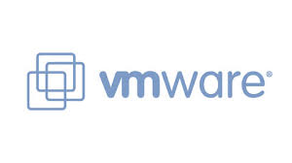
IBM Cloud Automation Manager – Pricing guidelines
Clients should purchase sufficient entitlement to cover the amount of Virtual Processor Cores (VPC) that are managed by CAM/ICP.
Client must purchase sufficient entitlement to cover :
VM based environments managed by CAM / ICP
Bare metal bare environments managed by CAM / ICP
Container based environment managed by CAM / ICP
Example: the CAM on ICP server runs on 8 VPC and manages three environments:
100 VMware VMs on-premises (2 VPC each, total of 200 VPC)
50 VMs on Amazon AWS (3 VPC each, total of 150 VPC)
2 Kubernetes clusters (16 VPC each, total of 32 VPC)
CAM on ICP requires entitlement for (200 + 150 + 32) 382 VPC
Notes:
Client is not required to purchase entitlement for the 8 VPC required by the CAM management server
If client opts to use the CAM Chef Server, the client is required to count VPCs used by the Chef Server for entitlement calculations
IBM Cloud Automation Manager in ICM Cloud Private
Management Server =
8 VPC
16
VPC
3 VPC
2 VPC
2 Clusters
50 VMs
100 VMs
27

Slide 28
ICO clients will be entitled to use CAM in ICP at no additional licensing cost
Preliminary Proposal– details being worked by Marco Sebastiani
Own today
Planned entitlement
IBM Cloud Orchestrator
or
IBM Cloud Orchestrator Enterprise
IBM Cloud Orchestrator
or
IBM Cloud Orchestrator Enterprise
IBM Cloud Automation Manager in ICM Cloud Private
+
The “IBM Cloud Orchestrator” software bundle will be updated to include the CAM/ICP software. Existing clients can download the new ICO bundle, which will then include the new CAM / ICP capabilities
The ICO license will be updated to include CAM/ICP as a “supporting program”, thus allowing ICO clients to use CAM/ICP.
ICO clients will continue to use their existing ICO entitlements, and will continue to pay maintenance as part of their standard ICO Service and Support.
For example, a client entitled to use a given amount of ICO RVUs will be able to consume ICO and CAM/ICP together
The combined size of the management environment can be up to the same amount of RVUs (or PVUs)
28

Slide 29
Pure clients will be entitled to use CAM in ICP at no additional licensing cost
Preliminary Proposal– details being worked by Nita Maheswaren
Own today
Planned entitlement
PureApplication System
W2500
Generation 1 & 2 Intel-based Systems
IBM Cloud Private + WAS (Container/VM) + DB2 (Container/VM) to manage and deploy to your PureApplication System
PureApplication System
W2700 & W3700
Generation 1, 2 & 3 Power-based Systems
PureApplication Software
For example, running on:
Bluemix Local System W3500 & W3550 (Generation 3 Intel-based Systems)
PureApplication Service Infrastructure
Client-managed Vmware or PowerVC environments
IBM Cloud Private
to manage and deploy to your Bluemix Local System
or any other supported
client-managed environments
PureApplication Software Software
For example, running on:
Bluemix Local System W3500 & W3550 (Generation 3 Intel-based Systems)
PureApplication Service Infrastructure
Client-managed Vmware or PowerVC environments
IBM Cloud Private + WAS (Container/VM) + DB2 (Container/VM)
to manage and deploy to your Bluemix Local System
or any other supported
client-managed environments
Notes: Minimum of 2,240 PVUs of PureApplication Software entitlement required. Limited to a total of 50 deployed Virtual Servers. A Virtual Server is defined as one running virtual machine using one or more virtual cores.
29

Slide 30
Cloud Automation Manager beta schedule
Aug | Sept | Oct | Nov | Dec
Cloud Automation Manager
Aug 31 CAM - Beta
Install CAM into IBM Cloud Private (Linux x86) with a Helm Chart
Automate provisioning into IBM Cloud, VMware vCenter and AWS EC2
Manage infrastructure as code with Terraform configurations
Integrate CAM template and service library with GitLab and GitHub Enterprise
Use starter packs and sample templates hosted in CAMHub
Workload and service instance management console
Integrated Chef runtime
Enterprise Middleware Library for Vmware
Integrate with UrbanCode Deploy
Oct 13 - CAM General Availability
CAM GA is dependent on GA of IBM Cloud Private
(new) Install CAM into IBM Cloud Private (LE Linux/POWER)
(new) Automate provisioning into Azure, PowerVC/AIX, PowerVC/LE Linux
(new) Support Terraform Plan/Apply day 2 actions
(new) Graphically compose services containing Terraform, Helm Charts, if/then conditions, email notifications and order forms
(new) Publish composed services into the IBM Cloud Private Service Broker Catalog.
Dec (date tbd) – CAM refresh
Bug fix release
Key
Dev Phase
Beta
GA
Notes:
We ‘sensed and responded’ to client feedback.
Pivot to prioritize a) support for containers based workloads b) on-premises workloads

Slide 31
Catalog of Terraform Content (August Beta)
Starter Library
Enterprise Middleware Library
MEAN stack, multi-cloud deployment template
LAMP stack, single VM deployment template
LAMP stack, multi-cloud deployment template
Strongloop Stack on a single VM template
Kubernetes cluster with NGINX template
MongoDB on a single VM template
Strongloop 3 tier deployment template
Strongloop Kubernetes cluster template
Node.js on a single VM template
Amazon EC2 virtual server with SSH key
Two virtual servers with SSH keys, 1 on private network template
One SoftLayer virtual server with SSH key template
One virtual server with SSH key template
Two virtual servers with SSH keys template
Supported OS: CentOS, Ubuntu (used in LAMP and MEAN, in addition to CentOS)
Target cloud: Varies by template
Apache HTTP Server Standalone Terraform configuration
IBM DB2 Standalone Server Terraform configuration
IBM HTTP Server Standalone Terraform configuration
WebSphere Liberty Single Server Terraform configuration
MQ Basic Single Queue Terraform configuration
WebSphere Application Server ND Standalone Server Terraform configuration
WebSphere ND Basic Cluster Terraform configuration
Oracle MySQL Standalone Terraform configuration
Apache Chef Automation Cookbook
Apache Tomcat Chef Automation Cookbook
Oracle MySQL Community Chef Automation Cookbook
MQ Chef Automation Cookbook
DB2 Chef Automation Cookbook
WebSphere Application Server ND Chef Automation Cookbook
WebSphere Liberty Chef Automation Cookbook
IBM Installation Manager Chef Automation Cookbook
IBM HTTP Server Chef Automation Cookbook
Supported OS: RHEL, Ubuntu (some payloads)
Target: VMWare
Roadmap: IBM Cloud, AWS EC2
31

Slide 32
Catalog of containerized workloads (IBM Cloud Private)
Current middleware
Management services
Cognitive, Analytics, & Data
WebSphere Application Server Network Deployment (WAS-ND)
Business Process Manager (BPM)
Operational Decision Manager (ODM)
Integration Bus (IIB)
WebSphere Message Queue (MQ)
DB2
Encryption & Key Management
Microservices Builder
API Connect
Log collection
Identity & Access Control
Audit
Usage/Metering
Data Science Experience (DSX)
Machine Learning
Watson Services
Redis
Elasticsearch
Etcd
Kafka
MongoDB
RabbitMQ
32

Slide 33
This presentation is intended for an IBM internal audience only.

Slide 34
IBM Cloud Private back up charts

Slide 35
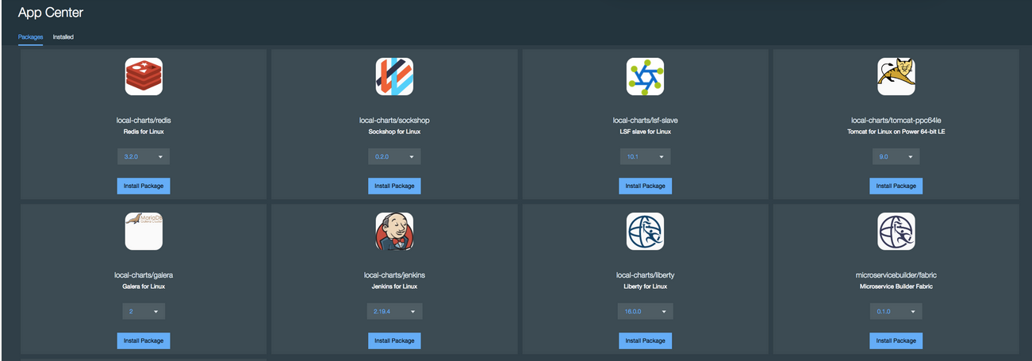
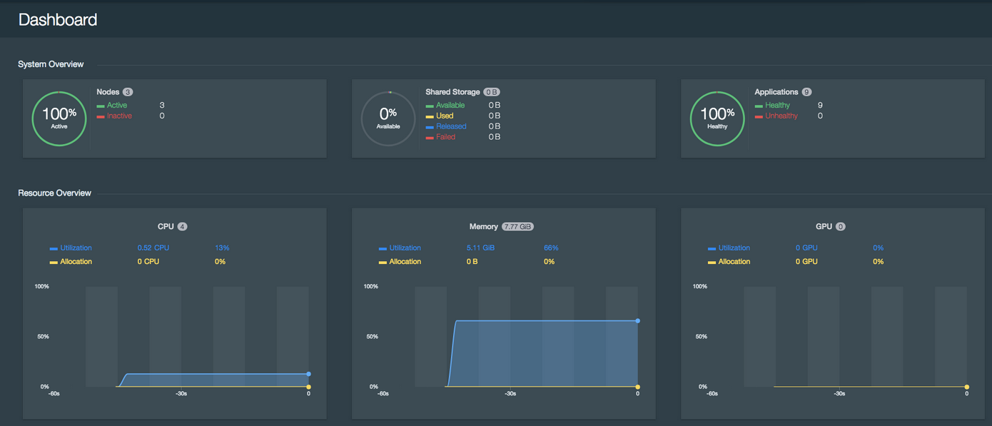
IBM Cloud Private: Overview
A private cloud platform for enterprises to develop, test and run their applications in their datacenters with full control
An integrated platform consisting of PaaS based on Kubernetes and developer services from IBM and partners
Announced and available on June 27
Evolution of IBM Bluemix Local, addressing the previous offering challenges and market needs more crisply
An important offering for delivering modernized IBM middleware and data services to enterprise customers, and and accelerating the enterprise path to cloud native applications
35

Slide 36
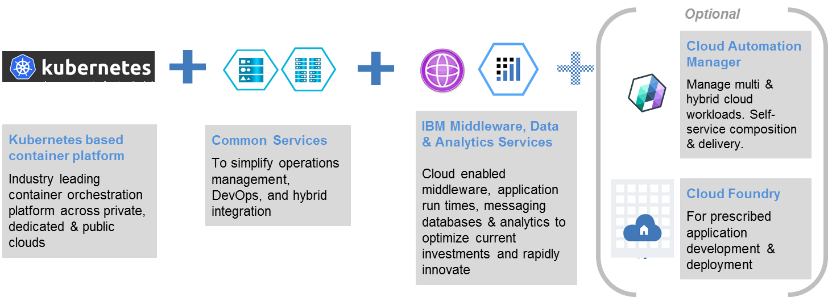
IBM Cloud Private: What’s in it?
Docker containers and Kubernetes
Service Catalog with a library of services
Included services: Liberty, Microservices Builder, DB2 DeveloperC (non-production), MQ Advanced for Developers, Redis, many other open source app dev tools
36

Slide 37


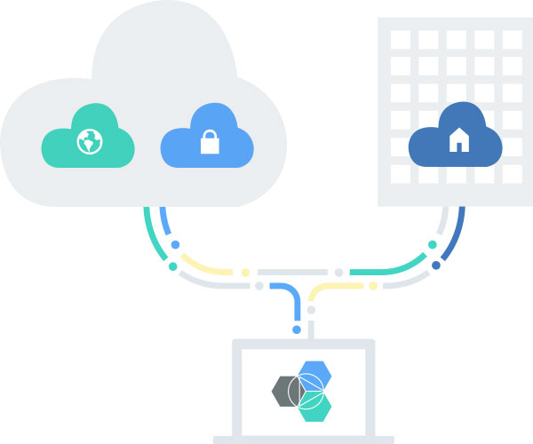



IBM Cloud Private (ICP) is central to IBM’s Hybrid Cloud Strategy
2 | Dedicated
Everything is dedicated and connected to you — agility of public cloud, yet feels like home.
Choice with consistency
Hybrid integration
1 | Public
Maximize on cloud economics and agility.
3 | Private
Behind the firewall for the most sensitive workloads.
DevOps productivity
Powerful, accessible data and analytics
Cognitive solutions
Seamless Experience
Regardless of which combination you choose, you can expect a single, seamless experience.
37

Slide 38
IBM Cloud delivers choice with consistency
Patterns
templates
Code +
Packaging as container image
Code +
manifest
Event/Action
API
User consumption
model
Event
Handlers
Cloud
Foundry
Custom
Scheduling
Kubernetes
Automation &
Orchestration
(Chef, Terraform etc.)
Service
(SaaS)
Containers
Containers
Containers
Docker
Garden -> Docker
Docker
Operating System
(e.g. Linux cgroups & namespaces)
38

Slide 39
Delivering Private and Hybrid Cloud
Unified Platform for Cloud Foundry + Containers –
common services (authentication, logging, etc.)
Single Pane of Glass – common monitoring and
management tooling across platform
Common User Experience – cohesive UI across platform for developers and operations
Private
Cloud
Platform
Secure Access to IBM Public Cloud - (Watson,
blockchain, etc.) enabled via key management facility
Support for All Java Requirements - WAS, Tomcat, Jboss and all Cloud-Native runtimes (node.js, etc.)
Middleware, DevOps & Monitoring Integration –
tight integration with NetCool, UrbanCode, IBM BPM
and other key IBM middleware
Integration with Larger
Ecosystem
39

Slide 40
IBM Cloud Private – What is it?
IBM Cloud Private delivers the advantages of public cloud in a client-controlled and secure environment.
Enterprises may leverage IBM Cloud Private to:
Develop and run production cloud-native apps in a private cloud
Securely integrate and use data and services from sources external to the private cloud
Refactor and modernize heritage enterprise apps
Protect sensitive data
Automated scalability
Operations efficiency and consistency
Client managed and controlled
Complete development environment
Meet compliance and
regulatory requirements
40

Slide 41
It’s easy to analyze, automate, land and transform workloads on IBM Cloud
Enterprise clients today run our existing software on-premises installed on bare metal machines and hypervisors of various forms.
Top use cases for transformation journey:
I want to optimize legacy apps with cloud
I want to extend my apps with cloud services
I want to create new cloud native apps
Private Cloud is an essential step to IBM Cloud. A local target for these workloads provides a ‘soft landing’, compared to going all the way to public cloud managed services.
Analyze for Insights
(PI)
Automation Engine and Content (CAM)
IBM
Private Cloud
IBM
Public Cloud
WAS
BPM
MQ
IIB
DB2
Insights on configuration, performance and usage
Leverage product insights, L&S Advisor, WAS Migration Tool,, etc.
Pre-built automation content for middleware, traditional and cloud native apps
Automated deployment
Day 2 ops, lifecycle management
Multi-cloud capable entry point
Benefits can include:
Cost, agility
Latency, sovereignty, security, control, connectivity, tenancy
Enterprise grade, Dev & Ops
Cloud native Docker/Kube
Core services for extended value, consistency and internal efficiency
Usage based pricing
Challenges can include:
Latency, sovereignty, security, control, connectivity, tenancy
…
Enterprise Software & Systems
Common Hybrid Cloud Platform
Private | Public
41

